Slide 1

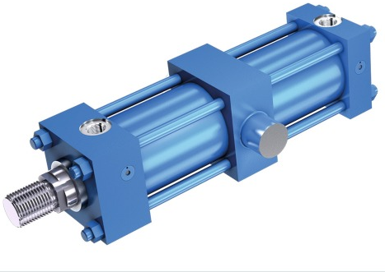
THE PREMIUM HYDRAULICS & ENGINEERING SOLUTION LLP.
Plot 56/10, D II Block, Near Mohan nagar Police Chowky, MIDC, Chinchwad,
Pune, 411 019, M.S., India.
9860795704
Email:-thepremium1125@gmail.com

Slide 2
Dear Sir/Madam,
We have the pleasure to introduce ourselves as THE PREMIUM HYDRAULIC & ENGINEERING SOLUTION LLP. located in CHINCHWAD,PUNE. We are typically cost effective when "off the shelf" solutions are not available. We have capabilities to design And develop the special purpose machines, material handling solutions And low cost automation solutions. We believe in customized product designing to meet the client’s specific need.
Along with are engaged in,
Designing And supply of hydraulic systems And power pack suitable to your application.
Designing And manufacturing of custom built hydraulic cylinders.
Technical consultancies for press shop industry.
System developments And up-gradations.
Press component quality improvement And Energy conservation ( Cushion And counterbalance automation in case of mechanical presses. )
Some of our esteemed clients with whom we are associated are;
Kirloskar oil engines Ltd. | CIE Automotive.
Jyotech Eng. & Marketing Consultant. | ARAI- homologation and technology centre Chakan.
Oasis Coils & Coatings LLC | K-flex India Private Limited.
JVS Comatsco Industries Private Limited. | Mixtrap Solutions Private Limited.
Excelsis Energy Private Limited. | Hira Technologies.
Cannon Indicos.

Slide 3
W
We would like to be associated with you as a supplier to work on any relevant assignments where we can benefit you. We request you to give us enquiries in the above mentioned areas which we can discuss further with you.
Thanking you and looking forward to favorable response.
Sincerely yours,
Mr.Radhakrishna Ghule
09860795704
rkghule@nbtindia.co.in
---:THE PREMIUM HYDRAULICS & ENGINEERING SOLUTION LLP.:---
:TRADITION: :INNOVATION: :DEDICATION:

Slide 4
We are in to :-
1. Design Development, Manufacturing & Supply of Hydraulic Systems & Hydraulic power packs.
2. Manufacturing & supply of Hydraulic Cylinders & Hydraulic Jacks.
3. Manufacturing & supply of Hydraulic operated CNG Intensifier & Hydraulic Accumulators.
4. Manufacturing & Supply of Hydraulic Pulsation Test Systems
5. Manufacturing & Supply of Hydraulic Test Systems & SPM.
6. Manufacturing & Supply of Hydraulic Operated Vertical Honing Machines.
7. Manufacturing & Supply of Hydraulic/ Gas Piston Type Accumulators.
8. Manufacturing & Supply of Spring-Loaded Hydraulic Accumulators.
9. Manufacturing & Supply of High-Pressure Hand pumps.
10. We are regularly Repairing, Testing & supplying Hydro-Pneumatic Pumps, Piston Pumps, Valves, Hydraulic Cylinders, Jacks, CNG Intensifiers, Piston Accumulators etc.
11. We are also supporting to Engineering Students in Project Work.
12. We are supplying seal kits for CNG Intensifiers.

Slide 5
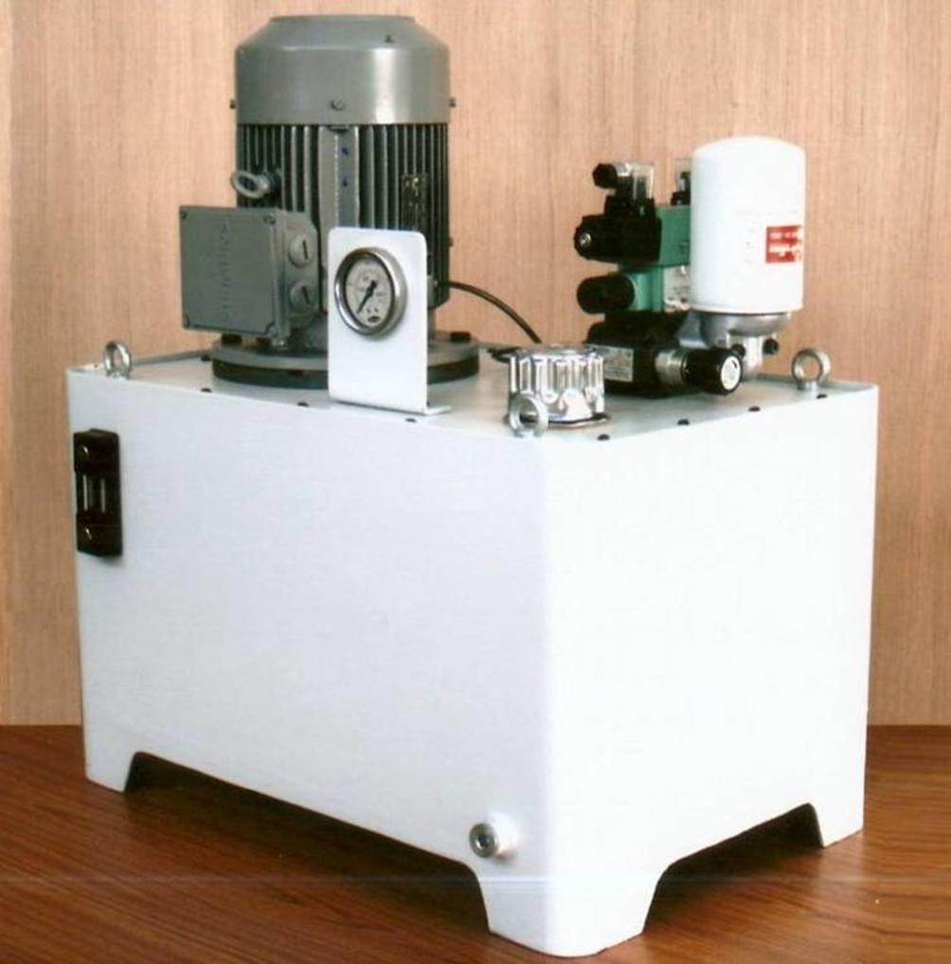
HYDRAULIC POWER PACKS
Max. pressure - 400 bar
Working pressure - 270 bar
Flow - 1.5 LPM
Drive motor - 2.2 kW,
Oil reservoir - 50 lit

Slide 6
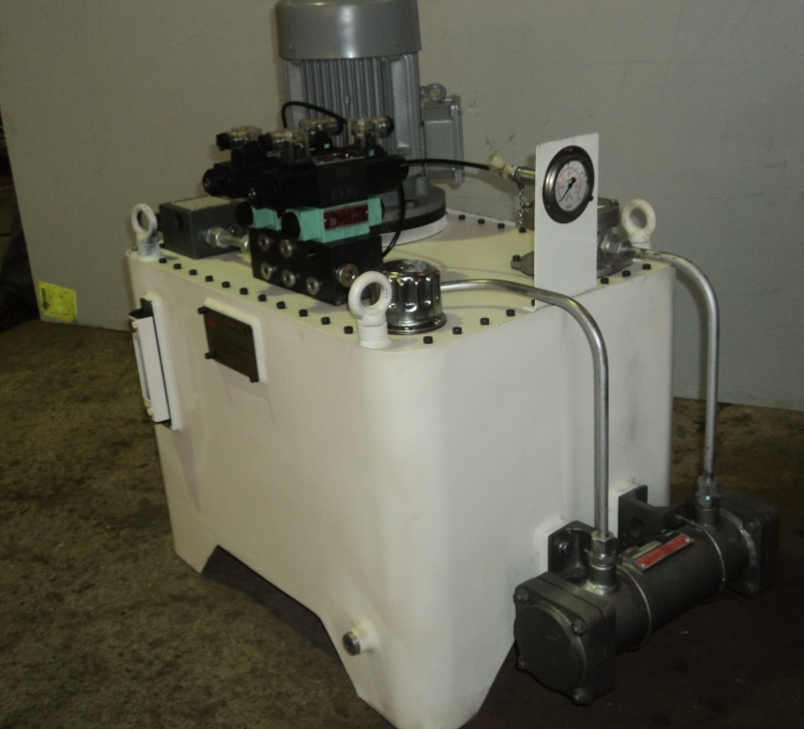
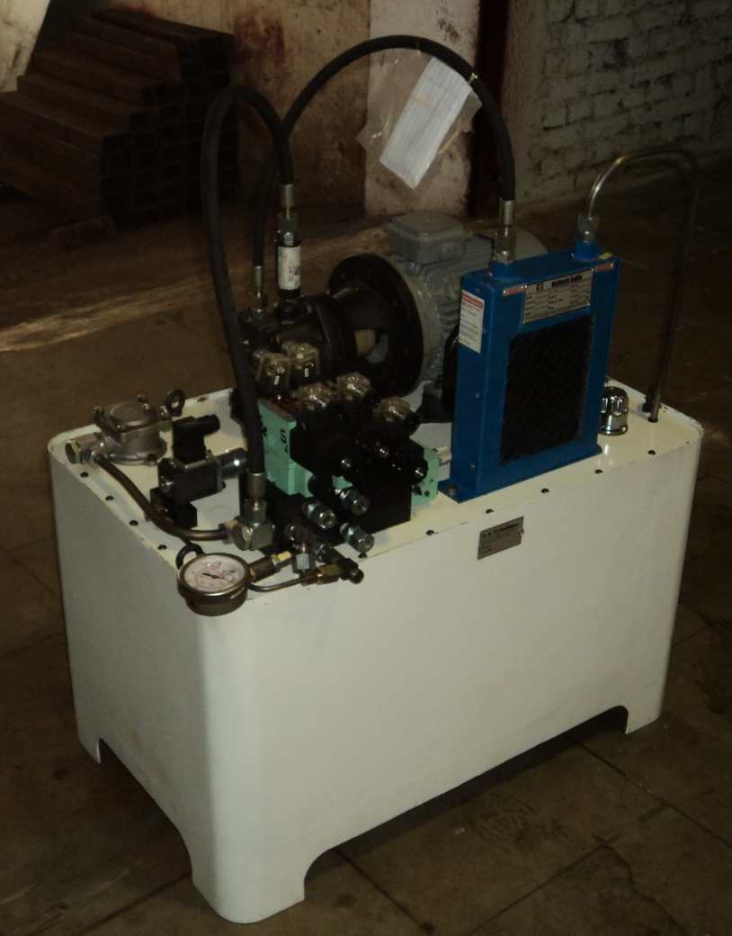
Max. pressure - 210 bar
Working pressure -160 bar
Flow - 12 LPM
Drive motor - 2.2 kW,
Oil reservoir - 50 lit

Slide 7
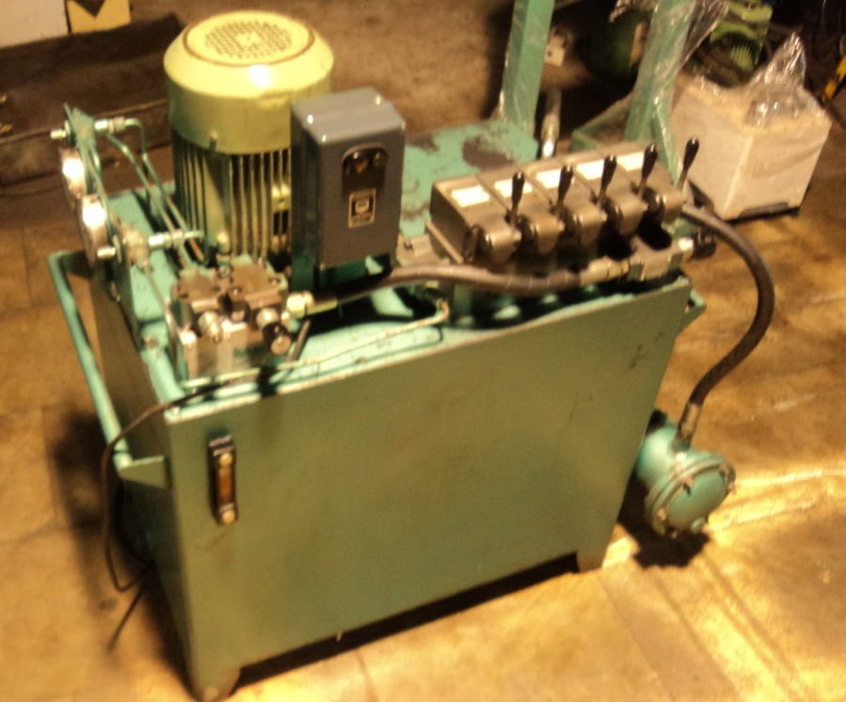
Max. pressure - 210 bar
Working pressure -180 bar
Flow - 52 LPM
Drive motor - 5.5 kW,
Oil reservoir - 140 lit
Application – Bricks Manufacturing industry.

Slide 8
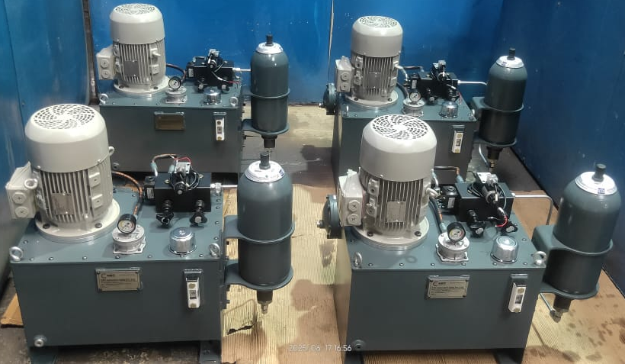
Max. pressure 300 bar, Working pressure 250 bar, Flow 10 LPM, Drive motor 3.7 kW, Oil reservoir 60 lit

Slide 9
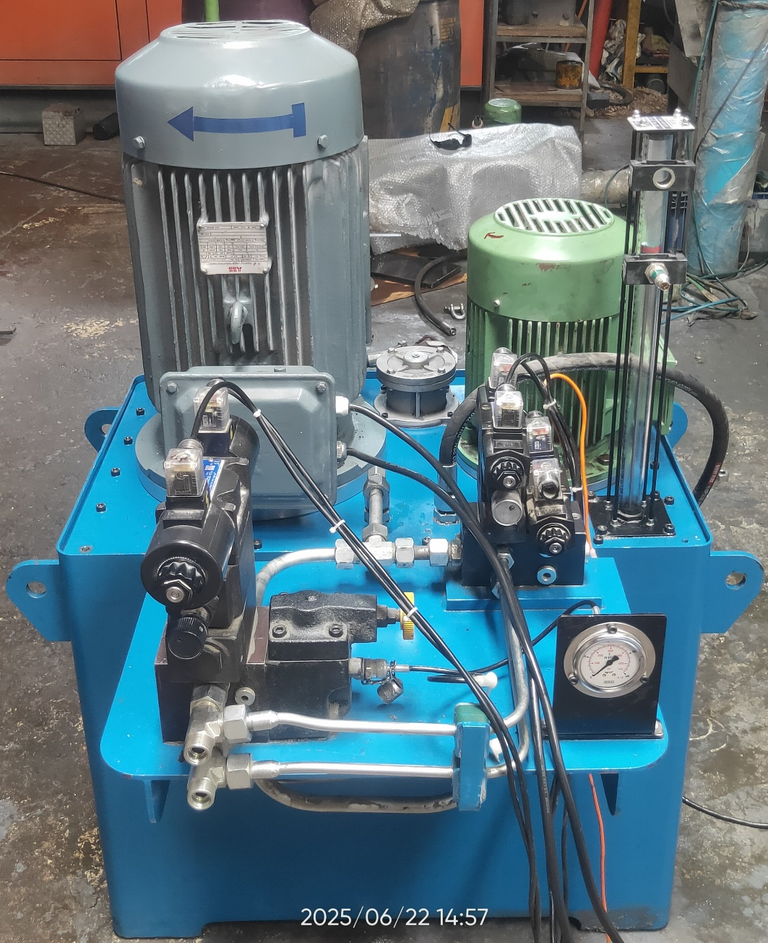
Max. pressure - 210 bar
Working pressure -160 bar
Flow - 42 LPM
Drive motor - 15 kW
Oil reservoir - 180 lit
Application- SPM

Slide 10
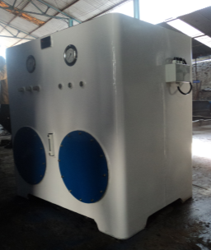
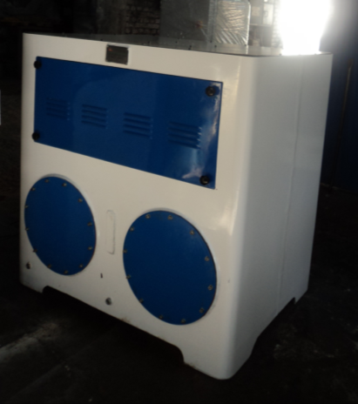
  HYDRAULIC POWER UNIT:-
Max. pressure 210 bar
Working pressure 180 bar,
Flow 80 LPM,
Drive motor 45 kW,
Oil reservoir 1000 lit.
Application- Coupling Testing.

Slide 11
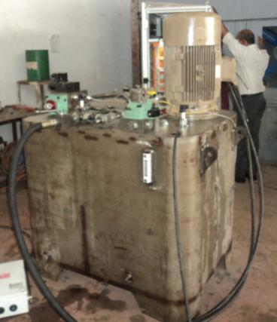
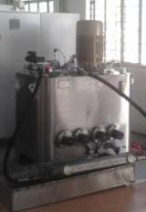
  HYDRAULIC POWER UNIT:- S. S. 304.
Max. pressure 250 bar, Working pressure 220 bar, Flow 40 LPM, Drive motor 22.5 kW, Oil reservoir 650 lit
Application- Radiator & Oil coolers Testing

Slide 12
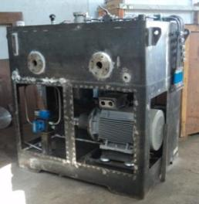
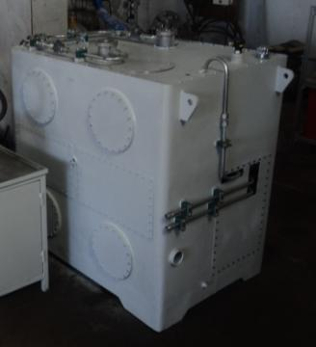
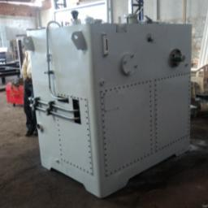
Max. pressure 250 bar, Working pressure 210 bar, Flow 80 LPM, Drive motor 45 kW, Oil reservoir 1200 lit.
Application – Hydraulic Component Testing

Slide 13
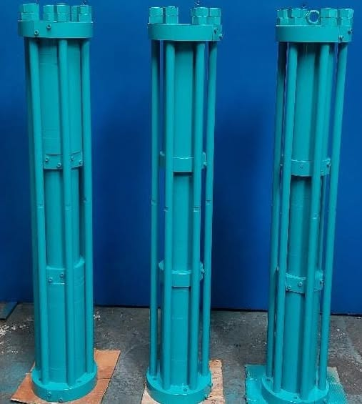
HYDRAULIC CNG INTENSIFIERS
Hyd. Working Max. Pressure:- 250 Bar
Hyd. Static test pressure :- 375 Bar
Operating speed :- 0.6 m/sec
Max .allowable speed for the seals:- 4 m/sec
Drive-Motor:- 22 |37 Kw (Flame Proof)
Flow Rate:- 450 | 650 SCMH
Max. Operating Temperature for Hyd. System :60ºc
Max. Operating Temperature for seals :- 260ºc
Cooling Method:- Air Cooling
Priority Panel:- 3 Lines (as per customer requirement)
Reliability:- 2000 Working Hours
Mounting:- Horizontal Mounting

Slide 14
Servo hydraulic fatigue rated actuators supplied to ARAI:-
Load capacity 250 KN, Stroke 500 mm & Stroke 700 mm.:-
Servo-hydraulic
actuators with
servo-valves and
built is stroke
measurement
sensors to operate
in precise load /
stroke control
modes at 10 hz
frequency

Slide 15
CNG-HYDRAULIC OPERATED BOOSTER ASSEMBLY with built in LVDT & proportional
controls to have flow and pressure controls of CNG
CNG BOOSTER :
It is used as a CNG Gas
Intensifier, which
compresses the CNG
Gas of low pressure to
high pressure to fill
Vehicle Gas tank.

Slide 16
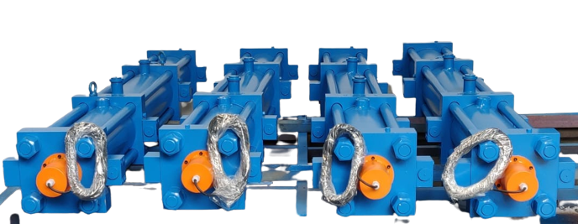
Hyd. Working Max. Pressure:- 250 Bar
Hyd. Static test pressure :- 375 Bar
Operating speed :- 0.6 m/sec
Max .allowable speed for the seals:- 4 m/sec
Drive-Motor:- 22 |37 Kw (Flame Proof)
Flow Rate:- 450 | 650 SCMH
Max. Operating Temperature for Hyd. System :-80ºc
Max. Operating Temperature for seals :- 150ºc
Cooling Method:- Air Cooling
Priority Panel:- 3 Lines (as per customer requirement)
Reliability:- 2000 Working Hours
Mounting:- Horizontal Mounting

Slide 17
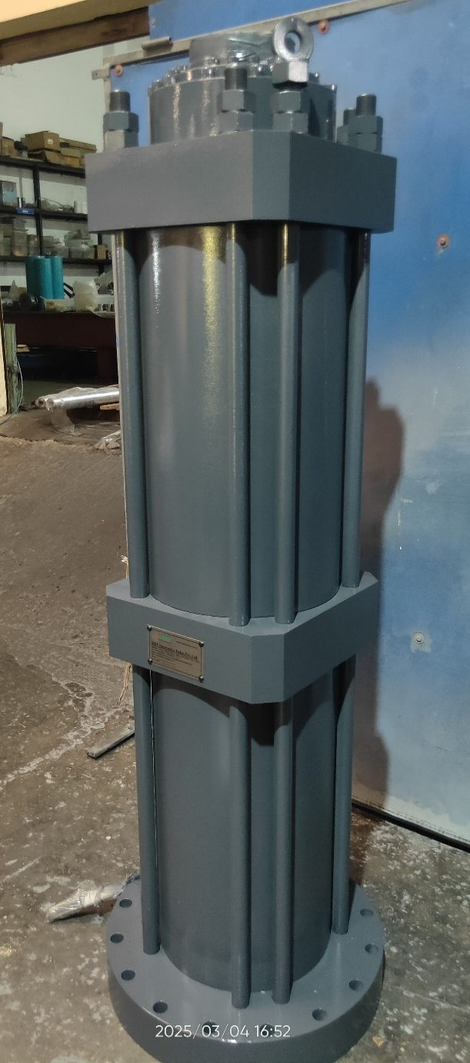
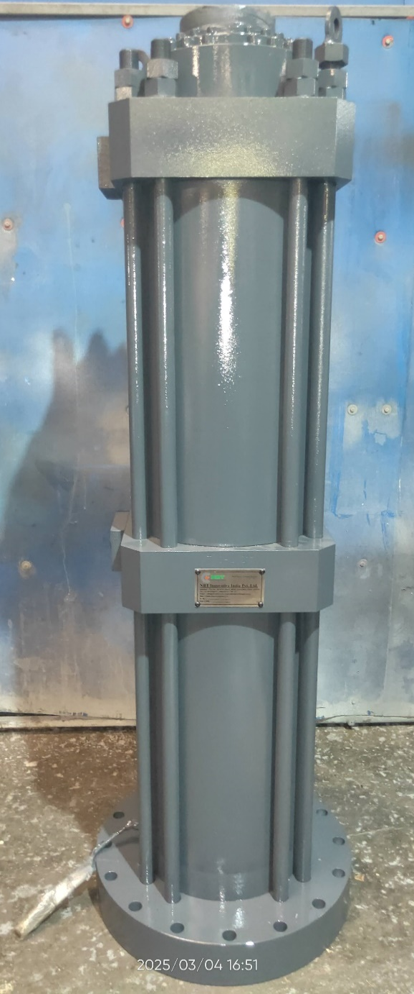
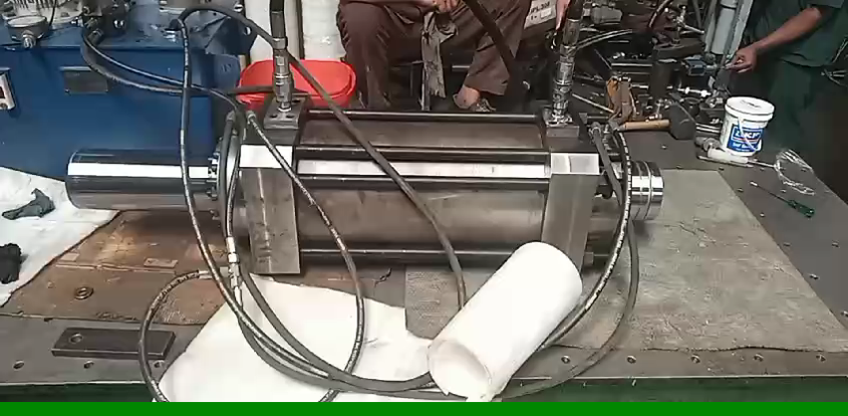
DOUBLE ACTING, DOUBLE ENDED & EQUAL AREA HYDRAULIC SERVO ACTUATOR.
Rod Dia. – 160 mm,
Bore Dia. – 280 mm,
Stroke Length – 400 mm.
Max. Working Pressure – 210 Bar
Operating Speed – 20 m/s

Slide 18
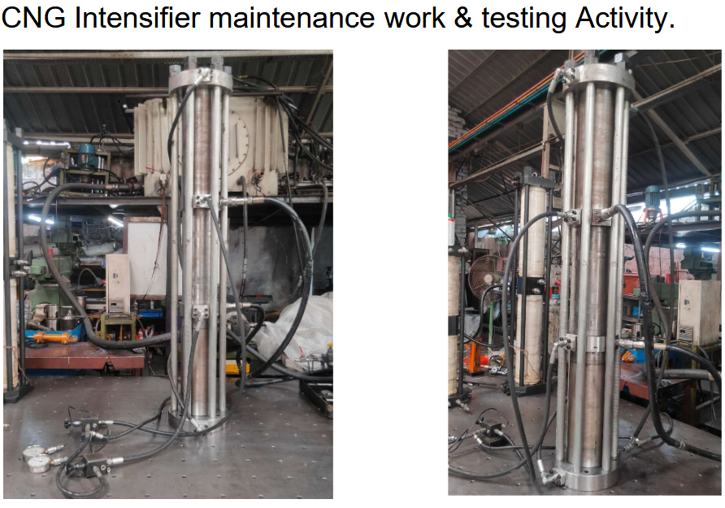
CNG Intensifiers

Slide 19
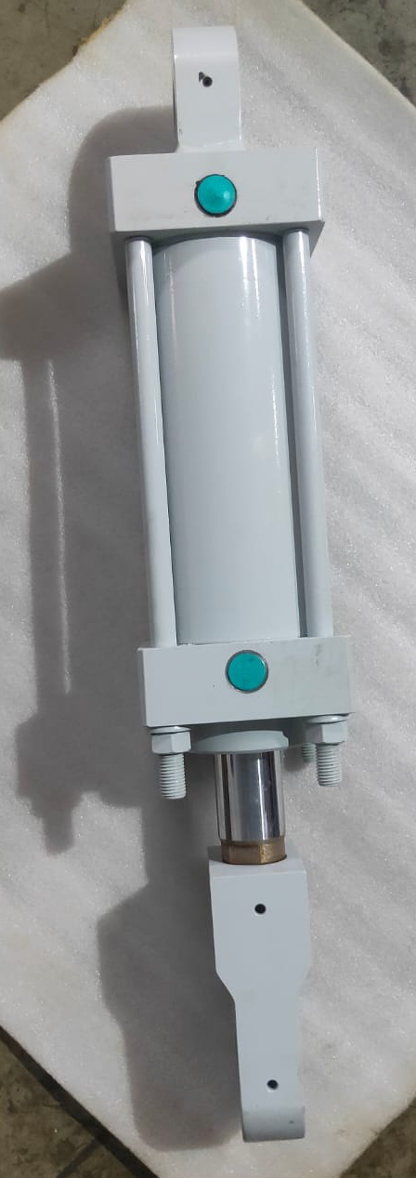
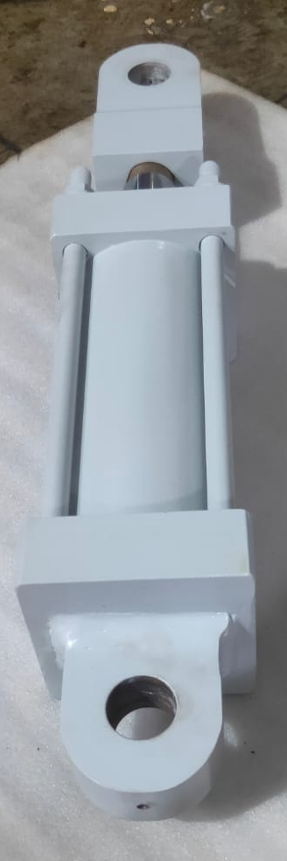
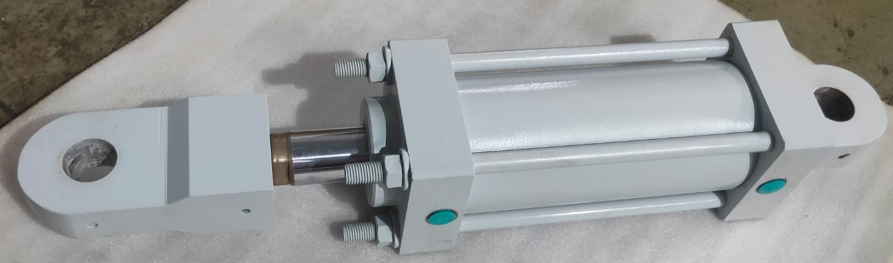
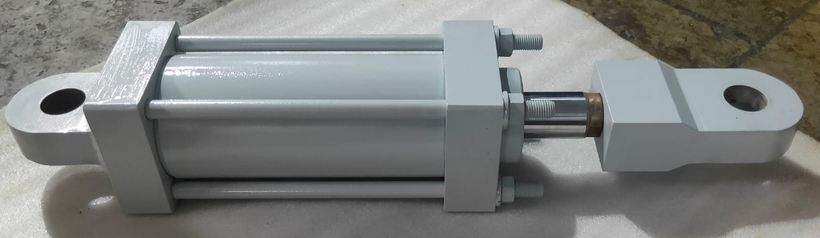
Specifications
Rod Dia. – 45 mm,
Bore Dia. – 100 mm,
Stroke Length – 150 mm.
Working Pressure – 160 bar

Slide 20
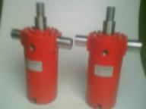
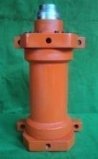
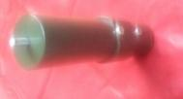
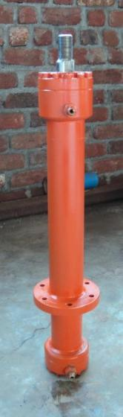

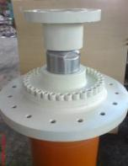
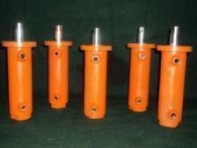
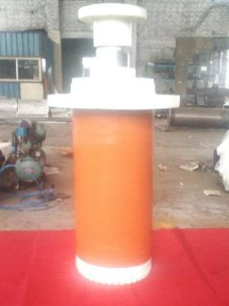
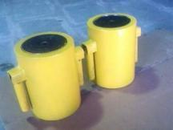
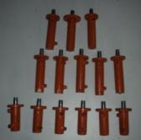
  SOME RECENT HYDRAULIC CYLINDERS SUPPLIED

Slide 21
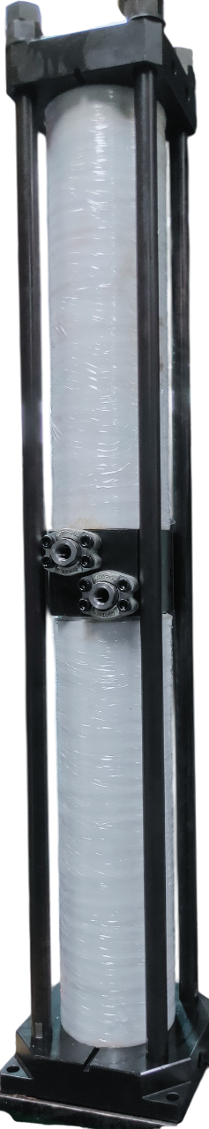
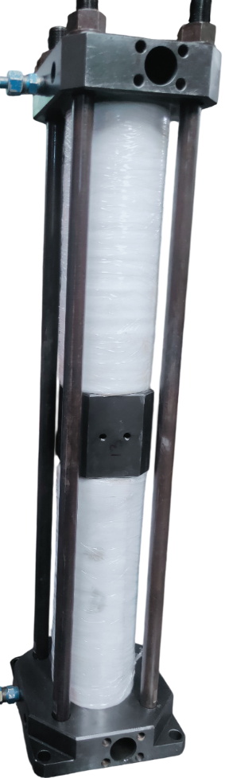
HYDRAULIC CNG INTENSIFIERS
Suction Pressure:-180 Bar
Operating Pressure:- 250 Bar
Drive-Motor:- 22 |37 Kw (Flame Proof)
Flow Rate:- 450 | 650 SCMH
Nº Cylinder / Nº stages :- 2/2
Seals:- Trelleborg Seal’s
Cooling Method:- Air Cooling
Priority Panel:- 3 Lines (as per customer requirement)
Weight:-625 Kg
Reliability:- 2000 Working Hours
Mounting:- Vertical Mounting

Slide 22
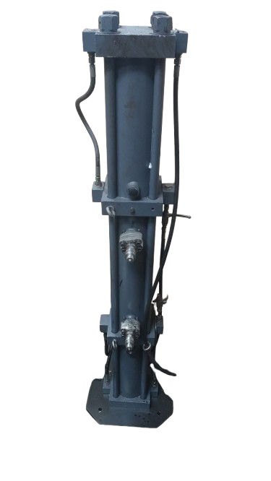
HYDRAULIC CNG INTENSIFIERS
Hyd. Working Max. Pressure:- 250 Bar
Hyd. Static test pressure :- 375 Bar
Operating speed :- 0.6 m/sec
Max .allowable speed for the seals:- 4 m/sec
Drive-Motor:- 22 |37 Kw (Flame Proof)
Flow Rate:- 450 | 650 SCMH
Max. Operating Temperature for Hyd. System :-80ºc
Max. Operating Temperature for seals :- 150ºc
Cooling Method:- Air Cooling
Priority Panel:- 3 Lines (as per customer requirement)
Reliability:- 2000 Working Hours
Mounting:- Horizontal Mounting

Slide 23
HYDRAULIC JACK
Specifications
Capacity – 100 Ton
Stroke Length – 150 mm.
Working Pressure – 700 bar

Slide 24
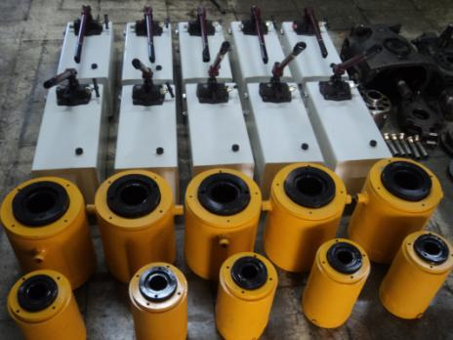
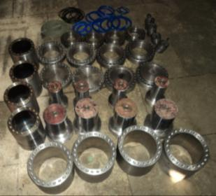
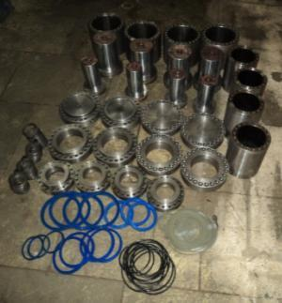
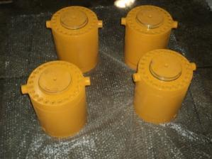
  HYDRAULIC JACK & HAND PUMP 700 BAR.
Supplied more than 150 hydraulic jacks ranging from 5 tons to 500 tons capacity.
Hollow jacks
Gravity fall single acting
Spring return jacks

Slide 25

MAINTENANCE ENGINEERING:
REPAIRING AND UP GRADATION OF EXISTING SYSTEMS
“OUR CARE TO YOUR EQUIPMENT'S; IMPROVES YOUR PRODUCTIVITY”
Do you face the problems that machines are out of warranty and it is expensive to maintain these machines?
Do you need agency to support your maintenance staff to maintain these machines or to sharpen their fundamental engineering skills?
Do you have hydraulically operated machines and facing problems for trouble shooting and maintenance?
Do you suffering from repetitive breakdowns or poor performance of any equipment or system?
Are you looking for an agency to develop & supply any spares which are not readily available or available but charged exorbitant by your current suppliers?
We have one stop solution for these problems you may be facing. We have gained immense exposure and experience in the area of maintenance engineering as well as development of product / SPMs / equipment; which we turn around and apply advantageously for your benefits.

Slide 26
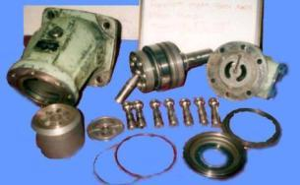
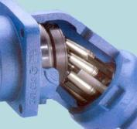
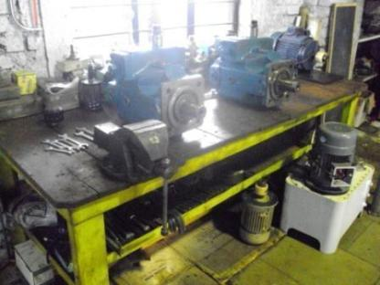
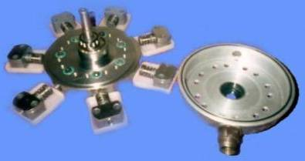
  HYDRAULIC PUMP REPAIRED
  Makes:-
  Hydro matic, Germany
  Rexroth, Germany
  Parker, France,
  Linde, Germany
  Yuken, Japan
  Atos, Itali

Slide 27
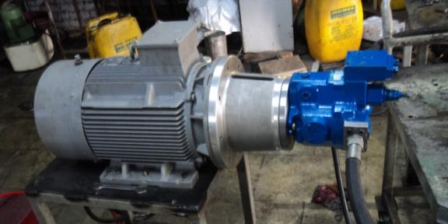
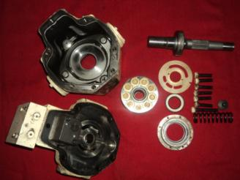
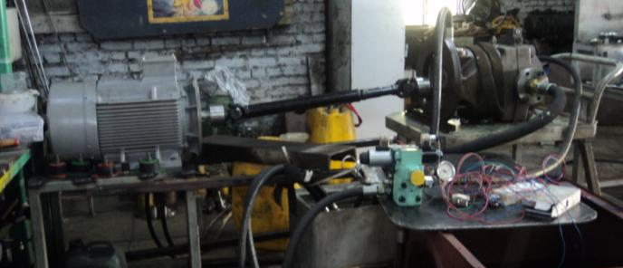
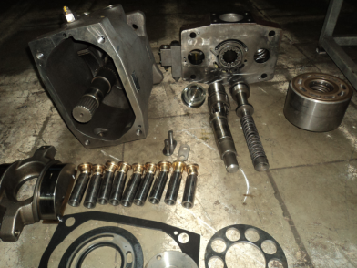
  HYDRAULIC PUMP REPAIRING AND TESTING,

Slide 28
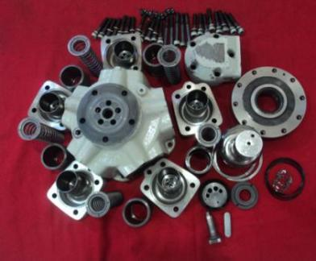
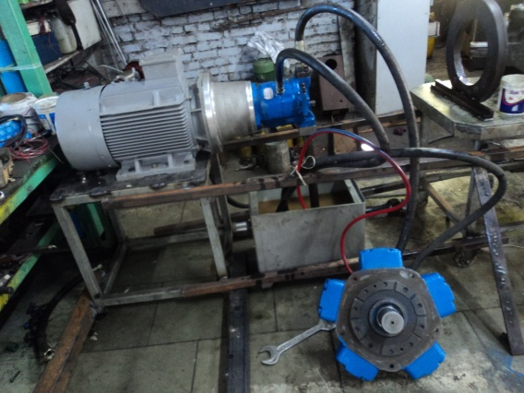

  HYDRO-MOTOR REPAIRED
  Makes:-
  Intra, Itali,
  Staffa, USA,
  Dusterloh, German
  Kawasaki, Japan

Slide 29




HYDRO-PNEUMATIC PUMP REPAIRING

Slide 30



HYDRO-PNEUMATIC PUMP REPAIRING

Slide 31

HYDRO-PNEUMATIC PUMP REPAIRING,

Slide 32




  HYDRAULIC OVERLOAD PROTECTION (DUMP) VALVES REPAIRED

Slide 33



  HYDRAULIC OVERLOAD PROTECTION
  (DUMP) VALVES REPAIRED
  Makes:-
  Erfurt, Germany

Slide 34



  HYDRAULIC SYSTEMS REPAIRED
Hydraulic clutch
brake system >>
Hyd. overload system
Hyd. special purpose power unit

Slide 35






HYDRAULIC ACCUMULATORS REPAIRING

Slide 36




HYDRAULIC VALVE REPAIRING
HYDRAULIC CYLINDER REPAIRING

Slide 37






Contact us
Address: Plot No. 67/12, D 3 Block, MIDC, Chinchwad, Pune-411019
FIND ME
+91-9860795704
THANK YOU…
thepremium1125@gmail.com

